Slide 1

Data analysis & Visualization Project
CTEC 298 – 101 Symbolic Computation use big data
Final Presentation
By: Torrodjae Somerville & Theresha Miller

Slide 2
introduction
This project applies the full data-science workflow using Python and Tableau
Each group member used their own dataset from CTEC 128 and reproduced the analysis using Python instead of Excel
Our work included loading data, cleaning and transforming datasets, creating six required Python plots, and building two Tableau visualizations
We documented the original datasets, the cleaned datasets, the code used, and the final outputs
The goal was to show that the same analytical process can be applied to different data sources
Demonstrated skills across Python, Jupyter Notebook, Matplotlib, Tableau, GitHub, NumPy, and Pandas

Slide 3
Ctec 128 Paper Summary: Group Leader
Topic:
  Analyzing COVID-19 case trends and vaccination patterns in Maryland
Dataset:
  COVID-19 cases by county and date.
  Vaccination rates by county (first dose and completed series)
  Focus on Maryland counties only
Key Steps:
  Removed unneeded columns and incomplete records
  Calculated Daily New Cases from cumulative totals
  Used mean, median, and standard deviation to describe the data
  Created charts to compare cases and vaccination trends over time
Main Finding:
  Short term: vaccinations and high case counts overlapped.
  Long term: as vaccination rates increased, daily new cases declined, showing vaccines helped control spread

Slide 4
Ctec 298 – course work summary (group leader)
Introduced to multiple data-focused tutorials and hands-on tasks to understand Python tools:
Learned and used several major tools & libraries:
  Jupyter Notebook – interactive coding environment (.ipynb)
  NumPy – numerical computing, arrays, math operations
  Pandas – data loading, cleaning, filtering, merging, grouping
  Matplotlib – Python plots (bar, pie, histogram, scatter, stack plot, multiplot)
  Tableau – visual analytics tool for building dashboards
  GitHub – repository for uploading files and managing code
Imported and uploaded multiple files into GitHub using past CTEC 128 data
Applied all tools to complete full workflow: load → clean → transform → visualize

Slide 5
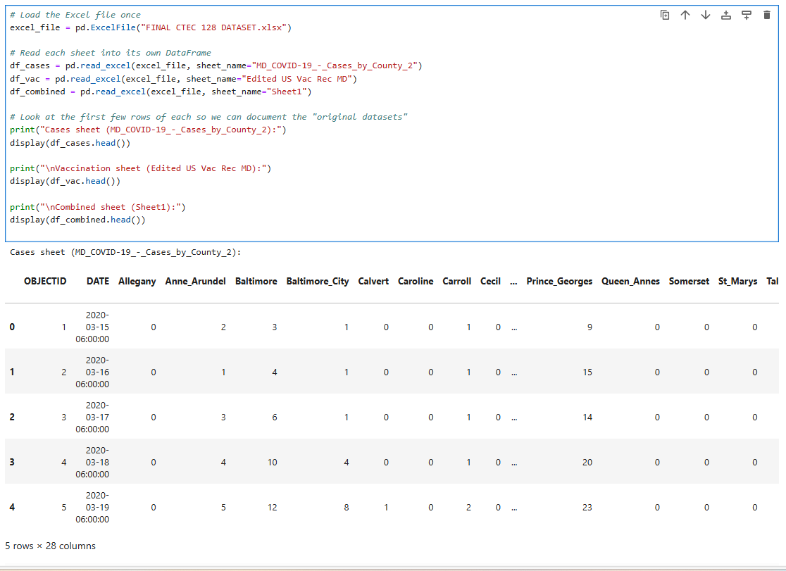
Orginial Datasets:
Original dataset 1 – Cases sheet
Sheet: MD_COVID-19_-_Cases_by_County
Example Columns:
  DATE
  County columns (Allegany, Anne_Arundel)
  Total Cases
  Daily New Cases

Slide 6
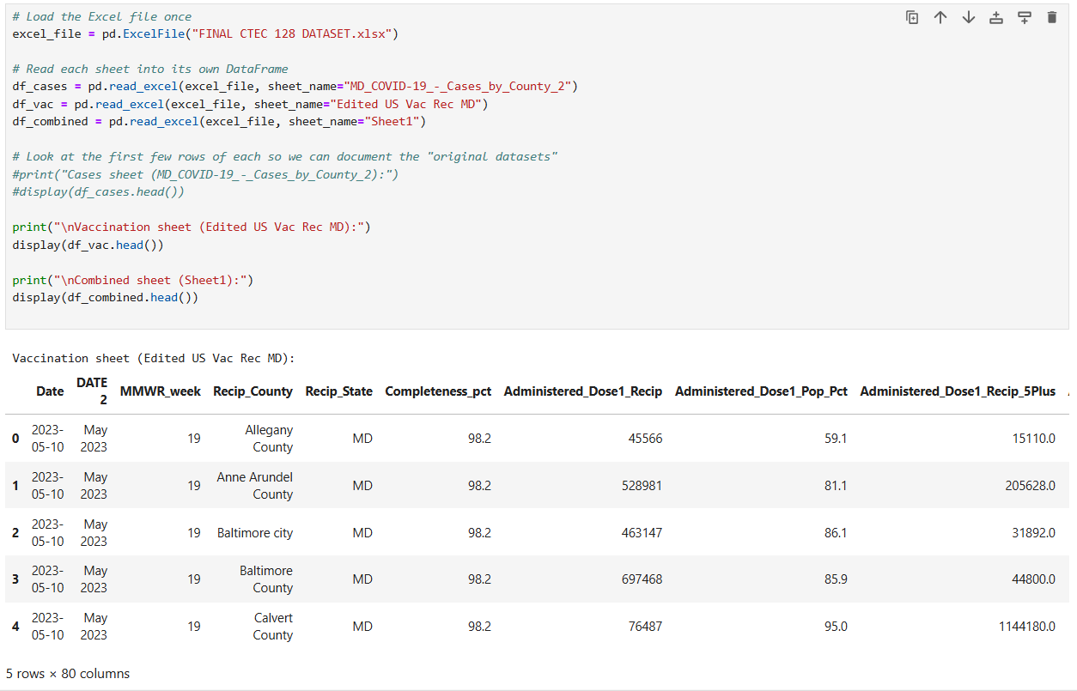
Original dataset 2 (Vaccination data)
Original dataset 2 – Vaccination sheet
Example columns:
  Date
  Recip_State
  Recip_County
  Administered_Dose1_Pop_Pct
  Series_Complete_Pop_Pct

Slide 7
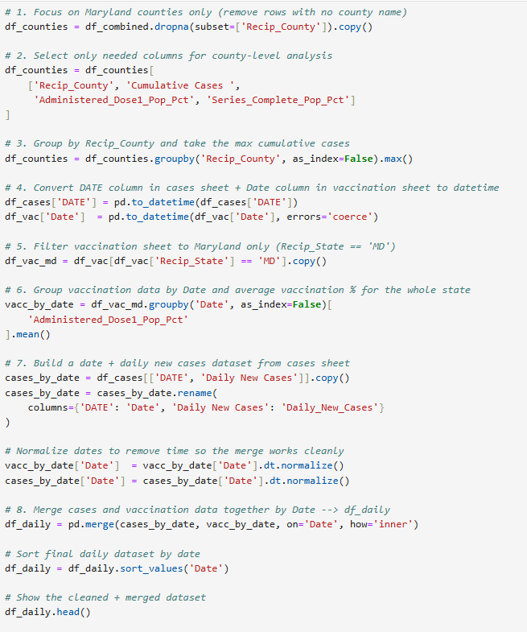
Data Cleaning & Wrangling Overview
Goals of cleaning:
Focus on Maryland counties only
Link cases and vaccination data
Build smaller “final” datasets for each plot
Main wrangling steps:
  Dropped rows without Recip_County
  Selected only needed columns for county-level analysis
  Grouped by Recip_County and took max cumulative cases
  Converted DATE and Date columns to real datetime
  Filtered vaccination sheet to Recip_State == 'MD'
  Grouped vaccination data by Date and averaged vaccination %
  Merged cases by date with vaccination by date into df_daily

Slide 8
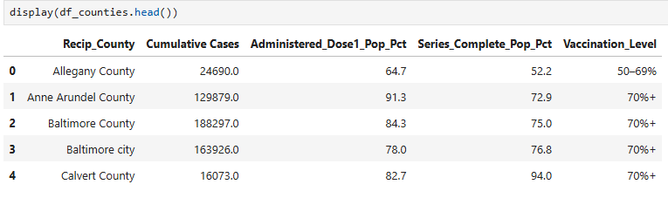
Bar plot: data used
Plot 1: Bar Plot – Cumulative Cases by County
Original dataset used:
df_combined (from Sheet1)
Cleaning / Final dataset (df_counties):
Dropped rows with missing Recip_County
Kept columns:
  Recip_County
  Cumulative Cases
  Administered_Dose1_Pop_Pct
  Series_Complete_Pop_Pct
Grouped by Recip_County and took maximum Cumulative Cases

Slide 9
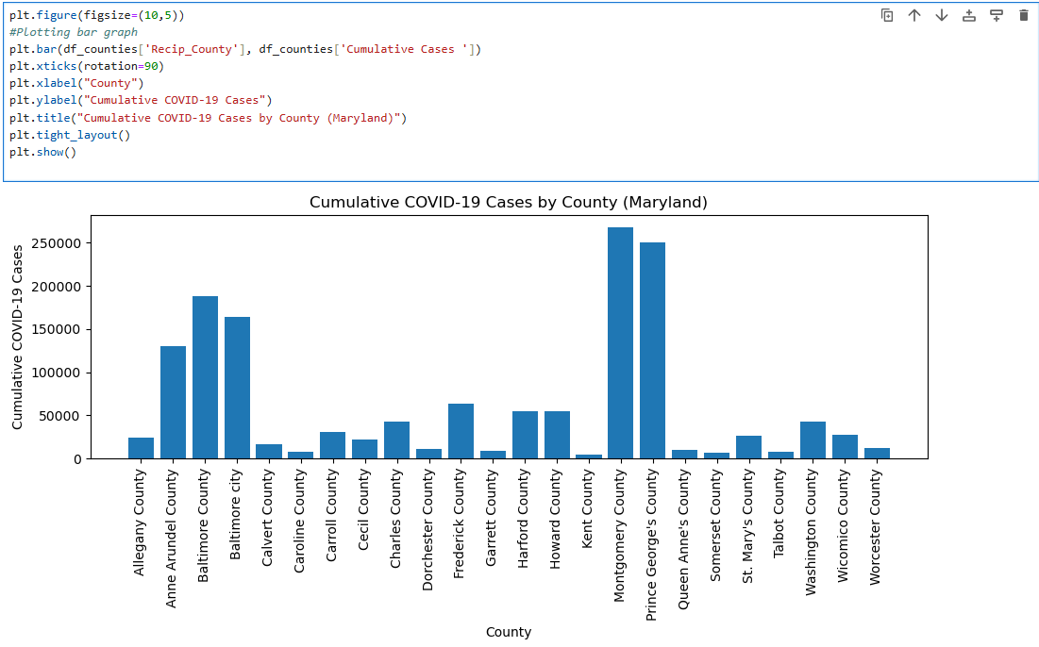
Bar plot: code & visualization
Key Python steps:
df_counties = df_combined.dropna(subset=['Recip_County'])
Selected needed columns for counties
groupby('Recip_County').max() to get one row per county
plt.bar(df_counties['Recip_County'], df_counties['Cumulative Cases '])
Plot interpretation (what it shows):
Shows which Maryland counties have the highest cumulative cases
Easy to compare counties side-by-side
Highlights counties with the greatest COVID-19 burden

Slide 10
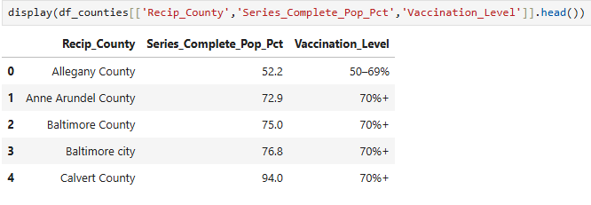
Pie Chart: Data & Categories
Plot 2: Pie Chart – Vaccination Level by County
Original dataset used: df_counties (cleaned county dataset)
Final dataset:
Added Vaccination_Level with categories:
  Below 50%
  50–69%
  70%+
Used value_counts() to count how many counties in each category

Slide 11
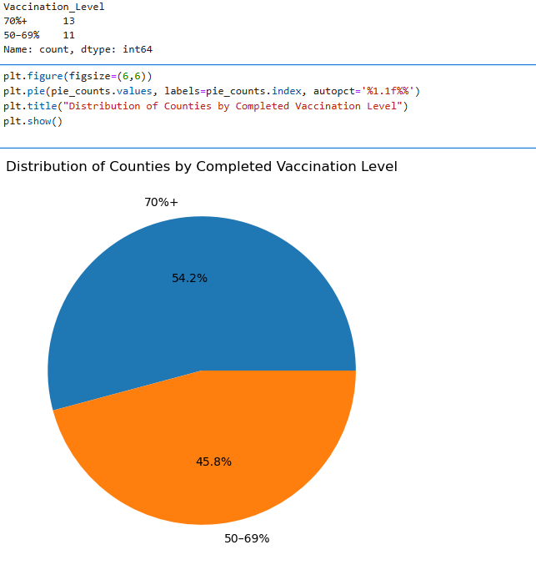
Pie Chart: code and visualization
Key Python steps:
Defined vacc_category(pct) function
Applied to Series_Complete_Pop_Pct → created Vaccination_Level
pie_counts = df_counties['Vaccination_Level'].value_counts()
Built pie chart with plt.pie(...)
Plot interpretation:
Shows percentage of counties in each vaccination level
Summarizes how well counties are doing overall with completed vaccination series
No Counties have below 50% of population Vaccinated

Slide 12
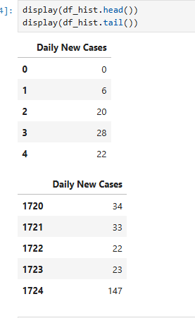
Histogram: Data Used
Plot 3: Histogram – Daily New Cases Distribution
Original dataset used:
df_cases (MD_COVID-19_-_Cases_by_County_2)
Final dataset (df_hist):
Kept one column: Daily New Cases
Represents number of new cases per day across Maryland

Slide 13
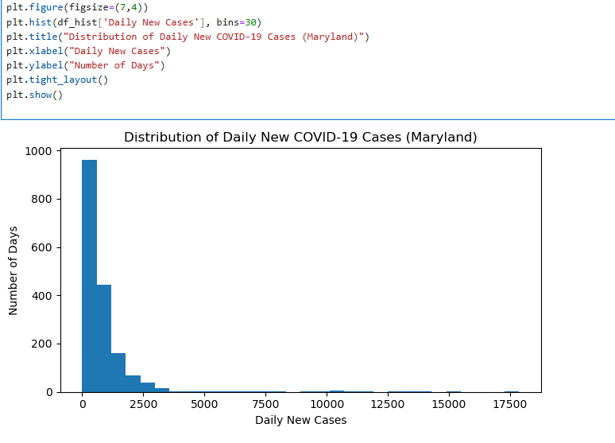
Histogram: code & visualization
Key Python steps:
df_hist = df_cases[['Daily New Cases']].copy()
plt.hist(df_hist['Daily New Cases'], bins=30)
Plot interpretation:
Shows how often certain daily new case counts occurred
Reveals whether most days were low, moderate, or high in new cases

Slide 14
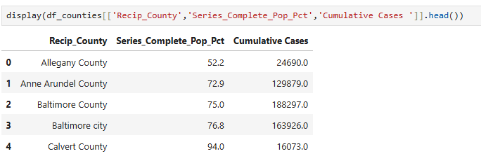
Scatter Plot: Data Used
Plot 4: Scatter Plot – Vaccination vs Cases (County Level)
Original dataset used:
df_counties
Final dataset (same DataFrame):
X-axis: Series_Complete_Pop_Pct (completed vaccination %)
Y-axis: Cumulative Cases

Slide 15
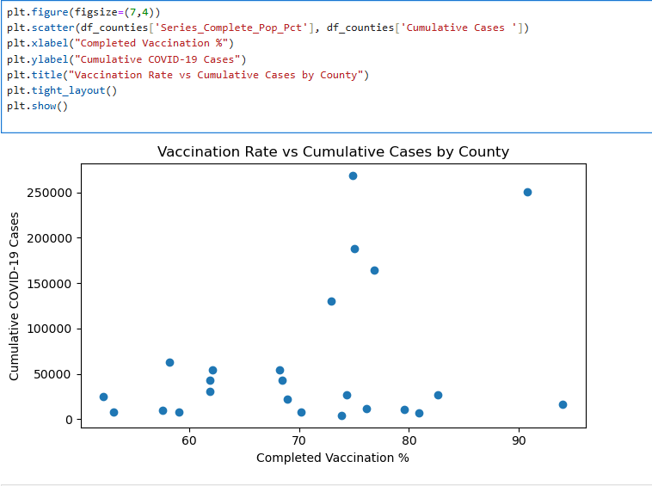
Scatter plot: code & visualization
Key Python steps:
plt.scatter(df_counties['Series_Complete_Pop_Pct'], df_counties['Cumulative Cases '])
Plot interpretation:
Each point = one county
Let’s us see how case totals relate to vaccination coverage
Encourages discussion about timing, population size, and county differences

Slide 16
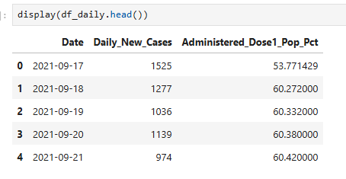
Stackplot: data used
Plot 5: Stack Plot – Vaccination & Daily Cases Over Time
Original datasets used:
df_cases (for Daily New Cases)
df_vac (for Administered_Dose1_Pop_Pct)
Final merged dataset (df_daily):
Columns:
Date
Daily_New_Cases
Administered_Dose1_Pop_Pct (average across Maryland counties)
Dates normalized and merged from both sheets

Slide 17
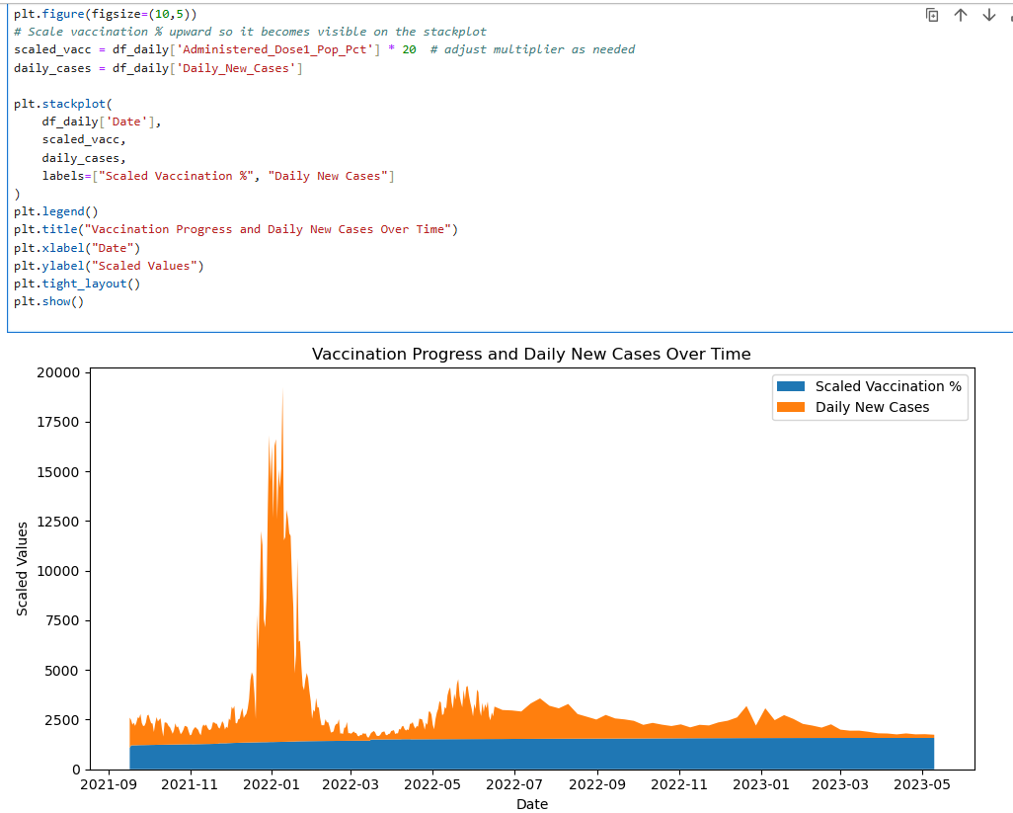
Stackplot: code & visualization
Key Python steps:
Converted both date columns to datetime
Filtered df_vac where Recip_State == 'MD'
groupby('Date')['Administered_Dose1_Pop_Pct'].mean() for statewide vaccination %
Built cases_by_date from df_cases[['DATE','Daily New Cases']]
Renamed and normalized Date columns
pd.merge(cases_by_date, vacc_by_date, on='Date', how='inner') → df_daily
Scaled vaccination % for visibility: scaled_vacc = df_daily['Administered_Dose1_Pop_Pct'] * 20
Used plt.stackplot(Date, scaled_vacc, Daily_New_Cases, ...)
Plot interpretation:
Shows vaccination progress and daily new cases on the same timeline
Makes it easier to see how trends overlapped and changed over time

Slide 18
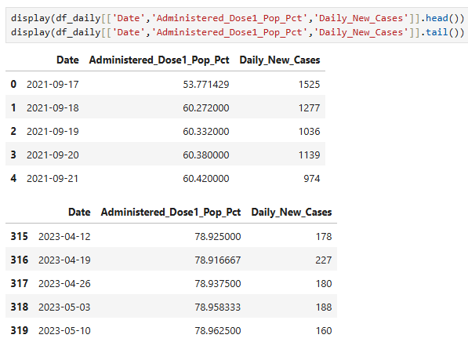
Multiplot: data used
Plot 6: Multiplot – Two Time Series
Dataset used:
Same df_daily as the stack plot
Columns:
Date
Administered_Dose1_Pop_Pct
Daily_New_Cases

Slide 19
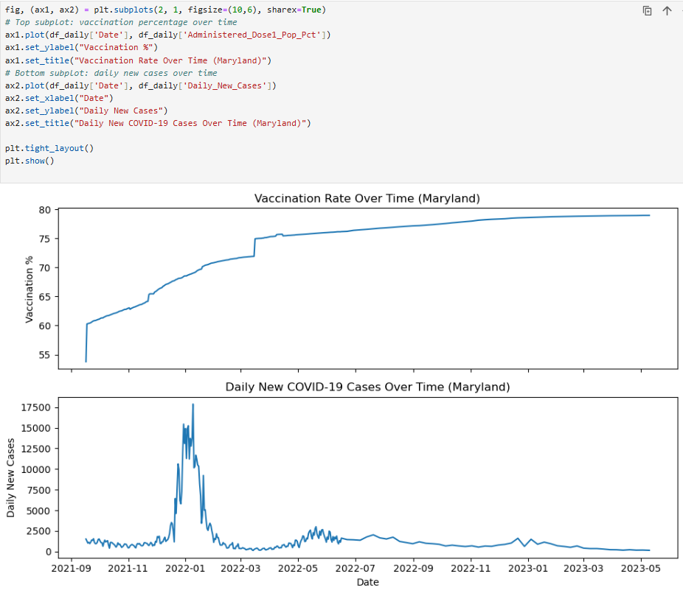
Multiplot: code & visualization
Key Python steps:
fig, (ax1, ax2) = plt.subplots(2, 1, sharex=True)
Top axis: ax1.plot(Date, Administered_Dose1_Pop_Pct)
Bottom axis: ax2.plot(Date, Daily_New_Cases)
Plot interpretation:
Separates vaccination trend and daily new case trend
Easier to compare shapes and timing between the two lines
Supports discussion of how long-term vaccination may relate to changes in daily cases

Slide 20
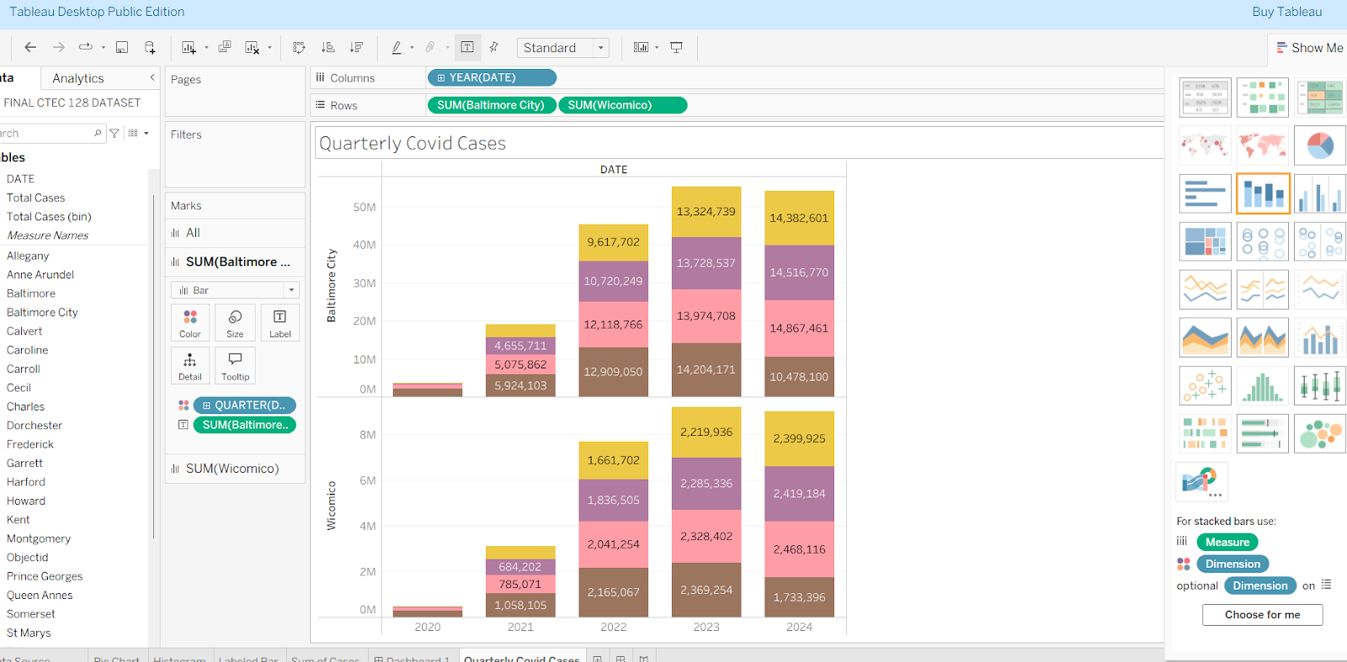
Tableau Plot #1: Quarterly COVID-19 Cases (Bar Chart)
Displays quarterly COVID-19 case totals for Wicomico and Baltimore City
Columns represent Year → Quarter (e.g., 2020 Q1–Q4, etc.)
Bars are stacked by category, showing how totals shift over time
Allows comparison of case levels between two counties on a quarterly timeline
Shows how both counties experienced noticeable jumps during early pandemic surges
Highlights seasonal patterns and differences in how each county was impacted

Slide 21
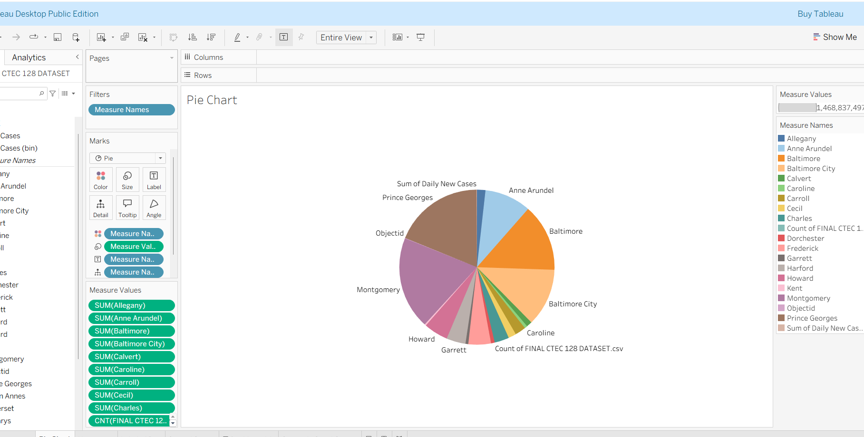
Tableau Plot #2: Daily New Cases by County (Pie Chart)
Pie chart shows share of total daily new cases contributed by each Maryland county
Slice size = sum of all daily new cases in the dataset for that county
Highlights counties with the highest overall impact
Baltimore City and Baltimore County contribute the largest portions
Smaller counties show noticeably smaller slices, reflecting lower total case counts
Offers a clear “big-picture” view of how heavily each area was affected

Slide 22
CTEC 128 Paper Summary: Member 2
Topic:
Occupation of African American Maryland residents aged 18-62 with a focus on gender
Dataset
Source: U.S. Census Public Use Microdata Sample (PUMS)
Population filtered:
Race: African American
Age: 18–65 (working-age population)
Employment status: Employed individuals only
Key steps:
Filtered dataset to include African American respondents aged 18–65 who were employed
Cleaned data by removing blanks, standardizing occupation labels, and grouping similar job titles
Consolidated occupations into broader categories (healthcare, service, management, transportation, education, administrative support)
Main Findings
African Americans are most concentrated in service, transportation, education, and healthcare support roles
Managerial and healthcare occupations showed higher mean and median earnings
Service and transportation roles reflected lower earnings overall

Slide 23
CTEC 298 Coursework summary (member 2)
Coursework Summary
Objective: Examined occupational representation and earnings among African Americans aged 18–65 using Census PUMS data.
Data Preparation:
  Filtered for African American working-age adults.
  Cleaned occupation labels and grouped jobs into major sectors.
Methods & Visuals:
  Bar and pie charts to show the most common jobs and sector distribution.
  Histogram and scatter plots to analyze wage trends and age-income relationships.
Key Findings:
  Representation spans many fields but clusters in service, healthcare support, education, and transportation.
  Higher earnings seen in management and healthcare roles; lower wages in service-related sectors.
  Patterns reveal equity gaps and limited access to higher-earning positions.
Relevance to Symbolic Computation / Big Data:
  Demonstrates cleaning, transforming, and analyzing large datasets.
  Shows how visualization reveals demographic and occupational patterns.

Slide 24
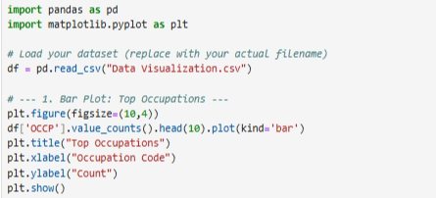
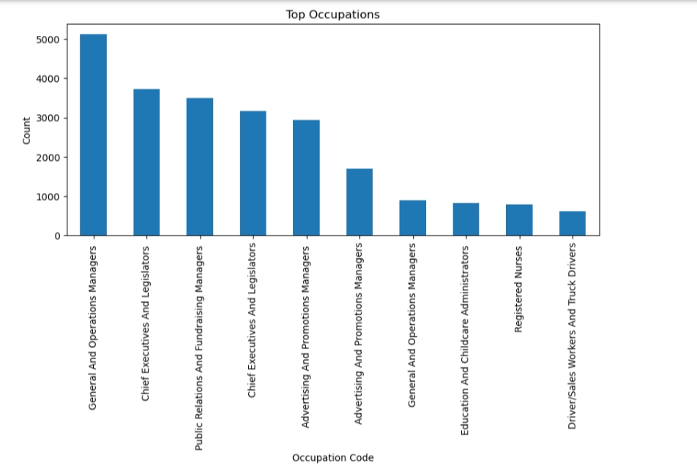
Bar Plot: Code & Visualization
Data Used
Dataset loaded from “Data Visualization.csv”.
Key column: OCCP
Represents occupation codes for individuals.
Key Python Steps
Loaded the dataset using pd.read_csv().
Counted how many times each occupation appears with value_counts().
Selected the top 10 most common occupations using .head(10).
Plotted the results as a bar chart with labels and a title.
Plot Interpretation
Displays the 10 most frequent occupations in the dataset.
Taller bars represent jobs with more individuals.
Highlights occupational concentration a few codes dominate the workforce.
Useful for identifying dominant job categories within the population.

Slide 25
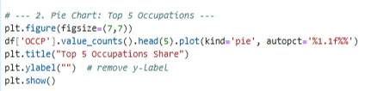
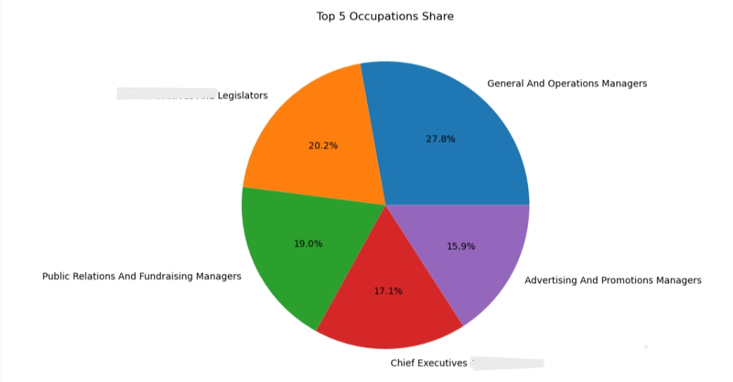
Pie chart: code & VISUALIZATION
Data Used
Dataset contains an occupation column (OCCP).
Each value represents a coded occupation for an individual.
Analysis focuses on the top 5 occupations by frequency.
Key Python Steps
Used value_counts() to calculate how many people are in each occupation.
Selected the top 5 occupations using .head(5).
Created a pie chart to show each occupation’s proportional share.
Used autopct='%1.1f%%' to display percentage values on the chart.
Plot Interpretation
Pie chart shows how the five most common occupations compare proportionally.
Larger slices represent occupations with more people.
Highlights that certain occupations make up a significant share of the dataset.
Helps visualize dominance or balance between major occupation categories.

Slide 26
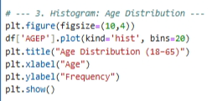
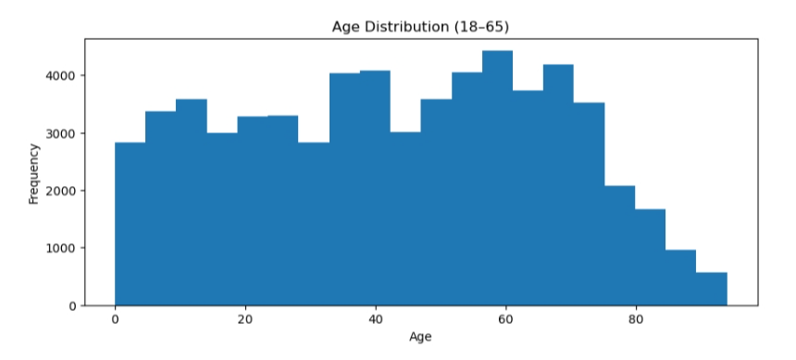
Histogram: code & VISUALIZATION
Data Used
Dataset includes an AGEP column representing individual ages.
Ages are assumed to be within a working-age range (18–65).
Key Python Steps
Selected the AGEP column for analysis.
Used .plot(kind='hist') to create a histogram.
Set bins=20 to divide ages into 20 equal-width groups.
Displayed the distribution with labeled axes and a title.
Plot Interpretation
Histogram shows how ages are spread across the population.
Taller bars represent age ranges with more individuals.
Helps identify:
  Most common age groups
  Whether the population is young-, mid-, or older-skewed
  Distribution shape (e.g., even, clustered, or declining)

Slide 27
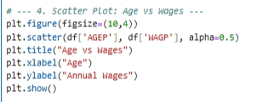
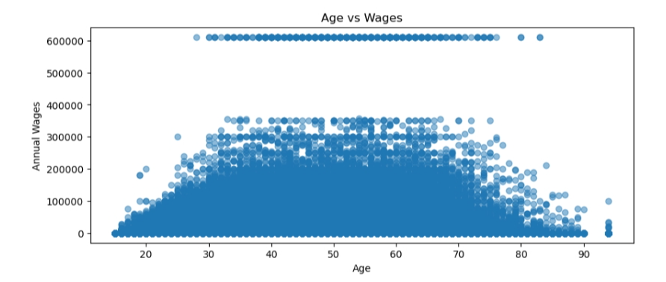
Scatter plot: code & VISUALIZATION
Data Used
Dataset includes:
  AGEP → Age of individuals
  WAGP → Annual wages or income
Used to analyze the relationship between age and earnings.
Key Python Steps
Retrieved age values (df['AGEP']) and wage values (df['WAGP']).
Used plt.scatter() to create a scatter plot.
Applied alpha=0.5 to make points semi-transparent for clarity.
Labeled axes and added a title for interpretation.
Plot Interpretation
Shows how wages vary across different ages.
Each dot represents one individual’s age and income.
Helps reveal trends:
  Wages may increase with age up to a point.
  Possible wide variation in income across ages.
No clear pattern may suggest many other factors affect wages.

Slide 28
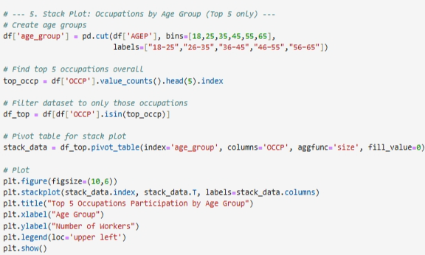
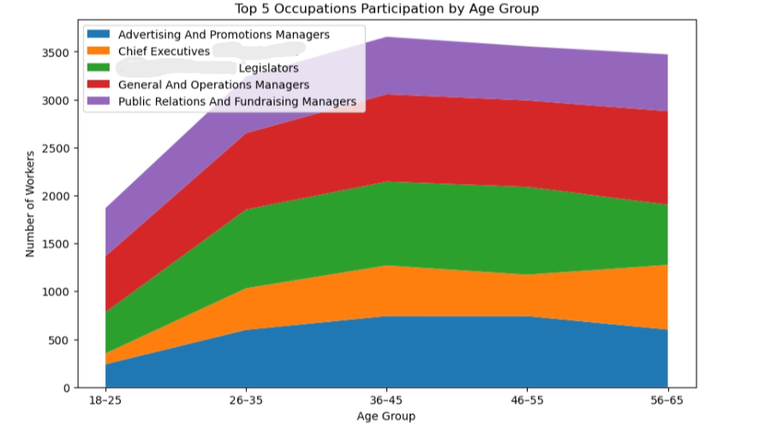
Stack plot: code & VISUALIZATION
Data Used
Dataset includes:
  AGEP → Age of individuals
  OCCP → Occupation code
Focuses only on the top 5 occupations.
Ages are grouped into five ranges:
18–25, 26–35, 36–45, 46–55, 56–65.
Key Python Steps
Created age group categories using pd.cut().
Identified the top 5 occupations using value_counts().head(5).
Filtered the dataset to include only those occupations.
Built a pivot table to count workers in each occupation by age group.
Created a stack plot using plt.stackplot() to compare participation across ages.
Plot Interpretation
Shows how the top 5 occupations are distributed across age groups.
Each colored area represents one occupation’s workers.
Wider sections indicate more workers in that age group.
Helps reveal:
  Which age groups dominate certain occupations
  How occupation participation shifts with age
  Whether some jobs attract younger vs. older workers

Slide 29
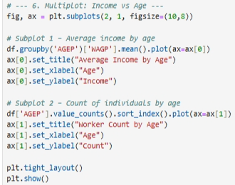
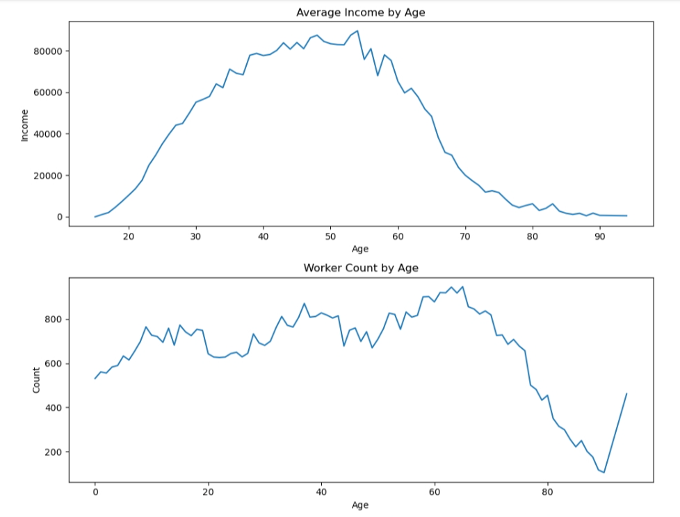
multiplot: code & VISUALIZATION
Data Used
Columns used:
  AGEP → Age of individuals
  WAGP → Annual wages/income
Used to analyze how income changes with age and population size per age.
Key Python Steps
Used groupby('AGEP')['WAGP'].mean() to calculate average income by age.
Plotted the average income trend in subplot 1.
Counted the number of individuals at each age using value_counts().
Sorted ages numerically and plotted counts in subplot 2.
Used plt.subplots() to place both charts vertically in one figure.
Plot Interpretation
Top plot (Average Income by Age):
  Shows how earnings increase, peak, or decline with age.
  Indicates whether income rises over time and at what ages it stabilizes.
Bottom plot (Worker Count by Age):
  Displays how many people are represented per age.
  Helps identify whether certain age groups are over- or under-represented.
Together they help answer:
  Do ages with higher income have more or fewer workers?
  How earnings progression relates to age distribution.

Slide 30
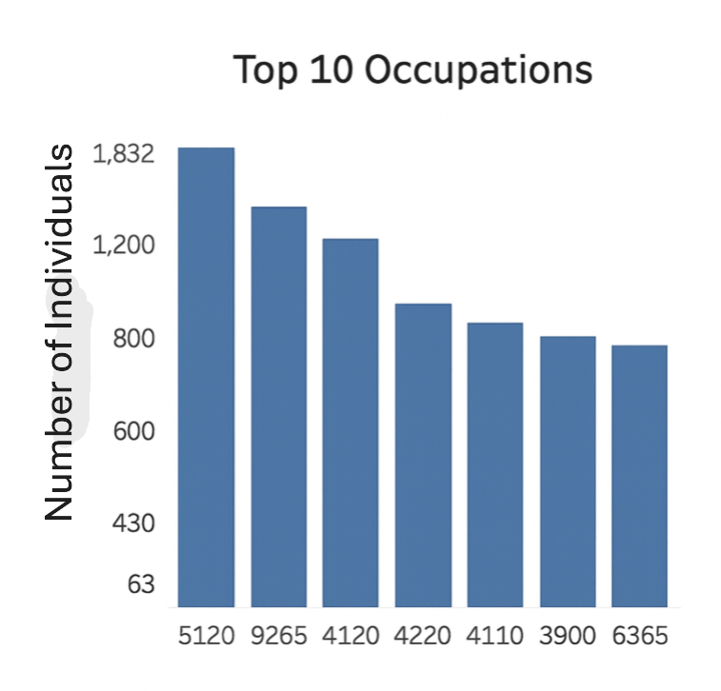
Tableau Plot 1 ( Bar chart)
What It Shows
A vertical bar chart displaying the 10 most common occupations in your dataset.
Each bar represents an occupation code (OCCP).
The height of the bar reflects the number of individuals in that occupation.
How to Interpret It
The taller the bar, the more people work in that occupation.
Occupation code Bookkeeping, Accounting, and Auditing Clerks has the highest count, meaning it's the most common job in your dataset.
Occupation code Electricians has the lowest among the top 10, but still ranks higher than all others not shown.
Key Insights
You can identify which occupations dominate the workforce.
This helps in understanding labor market concentration, where most people are clustered in a few job types.
If you're comparing regions or demographics, this chart can show which jobs are most prevalent in each group.

Slide 31
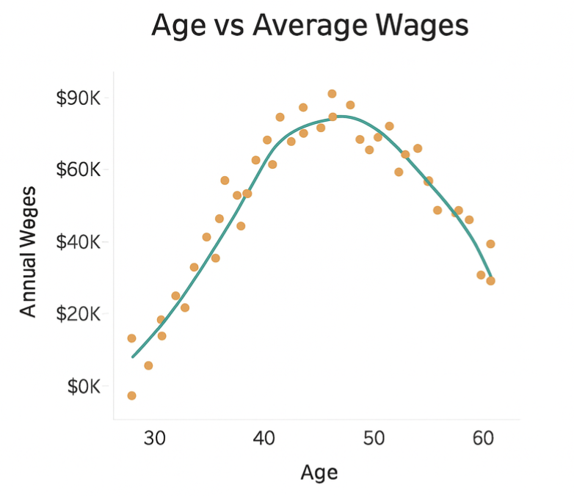
Tableau plot 2 ( Scatter Plot with Cure)
What It Shows
A scatter plot with orange dots representing individual data points (age vs wage).
A green fitted curve shows the overall trend in wages as age increases.
X-axis = Age (from 30 to 60), Y-axis = Annual Wages (from $0K to $90K).
How to Interpret It
Wages increase steadily from age 30 to around age 45.
After 45, wages plateau or slightly decline, suggesting a peak earning age.
The curve helps visualize the average wage trajectory across age groups.
Key Insights
This graph reveals the relationship between age and income.
It suggests that mid-career individuals (around 45) tend to earn the most.
Useful for analyzing career progression, income inequality, or retirement planning trends.

Slide 32
conclusion
This project showed how shared tools and methods can analyze very different datasets
Python allowed us to load data, clean it, merge datasets, calculate new variables, and build visualizations
Tableau provided additional visuals for deeper interpretation and clearer comparisons
Despite using different topics, both datasets followed the same process:
load → clean → transform → visualize → interpret
The six Python plots and two Tableau charts highlighted major trends, relationships, and patterns
Completing this project strengthened our understanding of real-world data workflows
The skills demonstrated—documentation, reproducible code, and visual communication—prepare us for future academic and professional work

Slide 33
References
Centers for Disease Control and Prevention. COVID-19 Vaccinations in the United States, County.
Maryland Open Data Portal. MD COVID-19 – Cases by County.
Somerville, T. (2024). Analyzing the Impact of COVID-19 Vaccination Rates on Case Trends in Maryland. CTEC 128 Data Science Project.
U.S. Census Bureau. (2023). American Community Survey: Public Use Microdata Sample (PUMS). Retrieved from https://www.census.gov/programs-surveys/acs/microdata/access.html Census.gov+1
U.S. Bureau of Labor Statistics. (2021). Labor force characteristics by race and ethnicity (Table 7 & Table 18). Retrieved from https://www.bls.gov/opub/reports/race-and-ethnicity/2021/home.htm

Slide 34

Thank You

